Slide 1
Smart Gas Heater

Slide 2
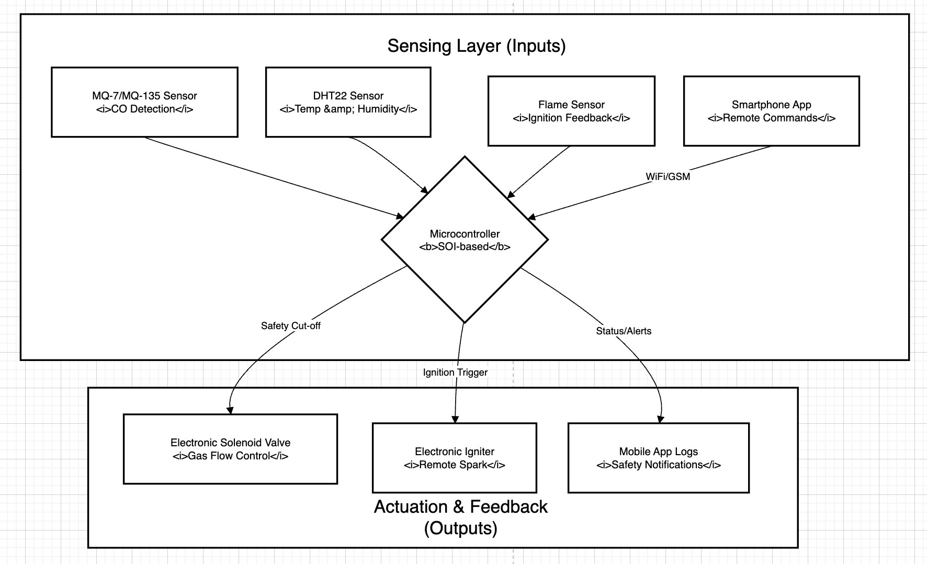
Smart Gas Heater Architecture

Slide 3
Smart Gas Heater):
Smart Gas Heater project is centered on the safety risks and technological limitations of traditional gas heaters:
Safety Risks: Traditional gas heaters pose serious risks to households due to carbon monoxide (CO) poisoning and hazards associated with unattended operation.
Lack of Monitoring and Control: These heaters lack modern features such as smart monitoring and remote control capabilities.
Design Limitations: In the initial development of the project, the controller box was too large, making it extra hardware that was cumbersome to carry.
Extreme Operating Conditions: Because heaters are made of metal, prolonged usage can cause the surface to reach temperatures exceeding 175 degrees Celsius.
This high-temperature environment creates challenges, such as performance drift in electrical components and the potential for standard materials (like FR-4 PCB substrates or leaded solder) to melt or fail.

Slide 4
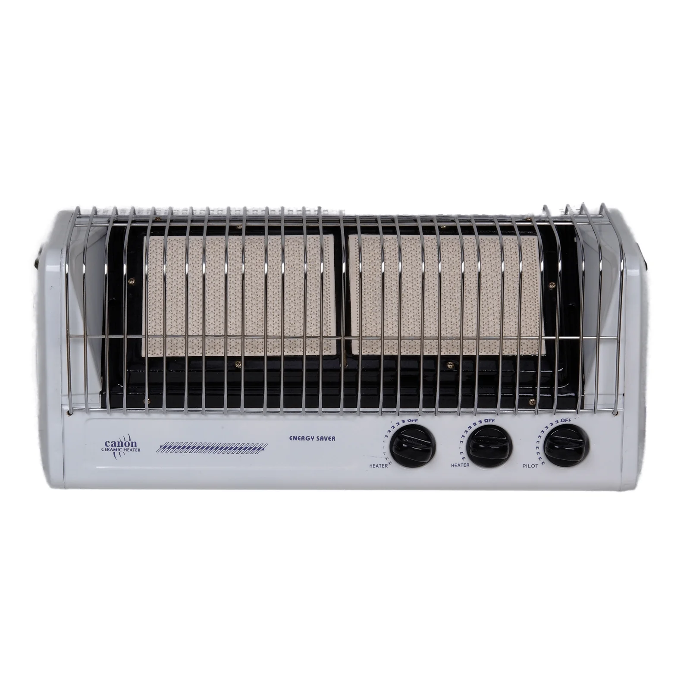
Traditional Gas Heater

Slide 5
Smart Gas Heater Architecture
The system operates by using a microcontroller to bridge environmental sensor data with
mechanical safety actuators and remote user commands.
Input Layer (Data & Commands):
DHT22 Sensor: Monitors ambient temperature and humidity.
MQ-7 / MQ-135 Sensor: Continuously monitors Carbon Monoxide (CO) levels.
Flame Sensor (Optional): Provides feedback to confirm successful ignition.
Smartphone App Interface: Sends remote ignition/shutdown commands and
receives real-time logs/alerts.
Control Layer (Processing):
Microcontroller (SOI-based for high temp): Processes sensor data against safety
thresholds and manages the heater's logic.

Slide 6
Smart Gas Heater Architecture
Output Layer (Action & Feedback):
Solenoid Valve: An electronically controlled valve that replaces the standard
manual valve to manage gas flow.
Electronic Ignition System: Facilitates remote startup of the heater.
Mobile App Alerts: Notifies the user if dangerous CO levels are detected or if the
system initiates an emergency shutdown.

Slide 7
Project Development Summary
This project identifies that traditional gas heaters pose risks such as CO poisoning and unattended operation.
To solve this, we developed a system with the following core capabilities:
Remote & Automatic Control: Users can ignite the heater via a mobile phone and set specific target temperatures for the room.
Safety Interlocks: The system is programmed to automatically shut down the gas supply if CO levels exceed a safe threshold or if the room temperature reaches a predetermined limit.
Hardware Evolution: To address the bulkiness of the initial controller box, we transitioned to a custom PCB designed to be mounted directly onto the heater's metal chassis.

Slide 8
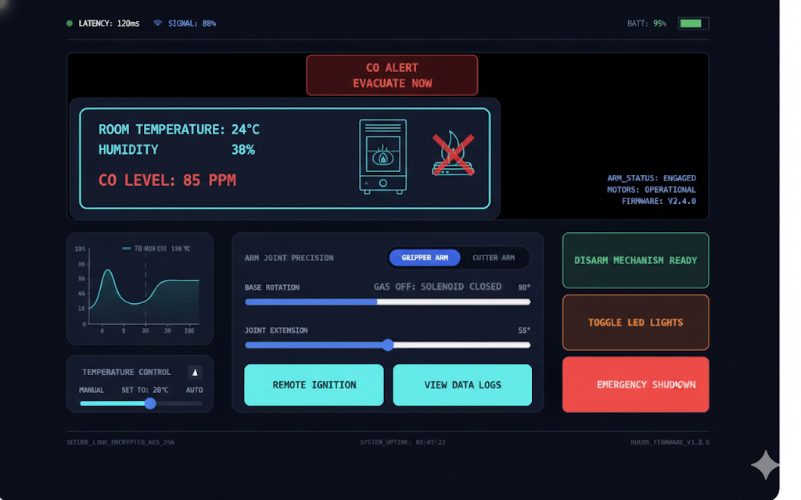
Smart Heater app

Slide 9
Critical Technical Challenges
The primary challenge identified in the presentation is High-Temperature Degradation, as the heater's metal surface can exceed 175°C.
We mitigated this through specialized engineering choices:
Substrate Selection: Using a polyimide substrate for the PCB because standard FR-4 fails above 170°C.
High-Temp Soldering: Utilizing high-lead (PbSn) or gold-based (AuSn) solders with melting points exceeding 280°C–300°C to ensure joints do not liquefy under thermal stress.
Component Hardening: Sourcing Silicon-on-Insulator (SOI) microcontrollers and high-temperature passive components (thin-film resistors and C0G ceramic capacitors) to prevent performance drift.

